Slide 1
Electronics Store Database Management System
Group 3
Group Members
Pradyumna Raghavendra, Vrishabh Vijayakumar, Maithili Rajendra Wade, Deepak Kumar Somasundaram, Siddhesh Nikam

Slide 2
Project Overview
1
Mission
2
Challenges
3
Objectives
The Electronics Store Management System is a database-driven solution designed to streamline and automate the operations of an electronics retail store. The system manages key business processes including inventory tracking, sales processing, customer management, and supplier coordination.
Manual inventory tracking leading to stock discrepancies
Inventory Management - Track stock levels accurately, prevent shortages
Sales processing errors resulting in revenue loss
Sales Processing - Automate billing and invoicing, reduce errors
Unstructured supplier coordination causing procurement delays
Customer Management - Store customer information.
Limited financial insights affecting business decision-making
Supplier Coordination - Maintain supplier relationships, streamline procurement
Employee performance monitoring difficulties
Financial Reporting - Generate detailed reports for business insights
4
Business Rules:
User Management
Each employee must register with a unique Employee ID and Access levels are assigned based on roles
Inventory Management
Each product has a unique Product ID and Stock levels are updated in real-time upon sales and restocking and Low-stock alerts are generated at predefined thresholds
Sales Processing
Each sale must be recorded with an invoice and linked to a registered customer. Discounts and promotions are applied based on predefined conditions

Slide 3
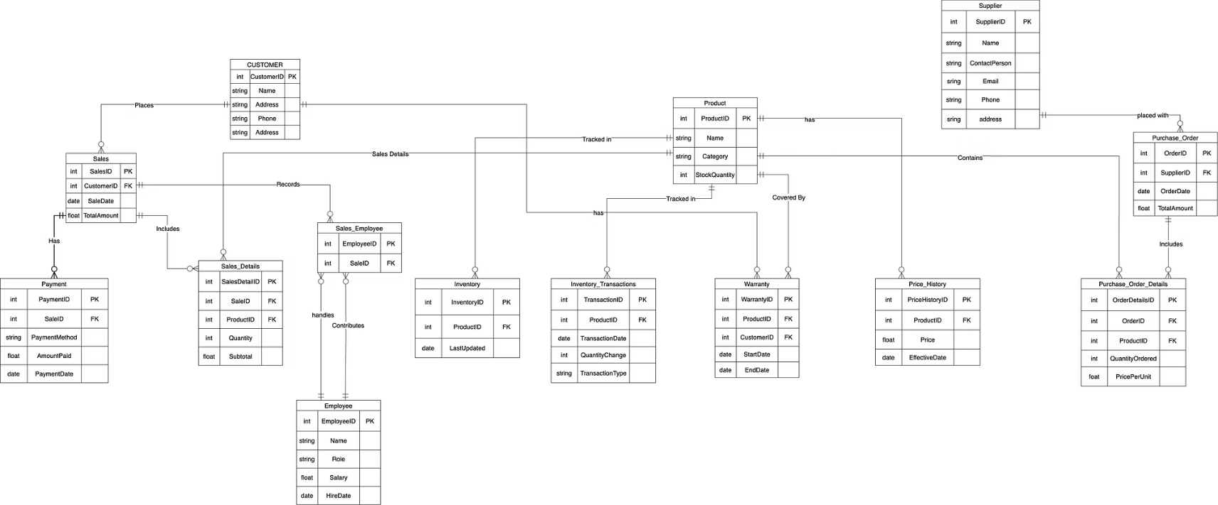
Entity Relationship Diagram (ERD)

Slide 4
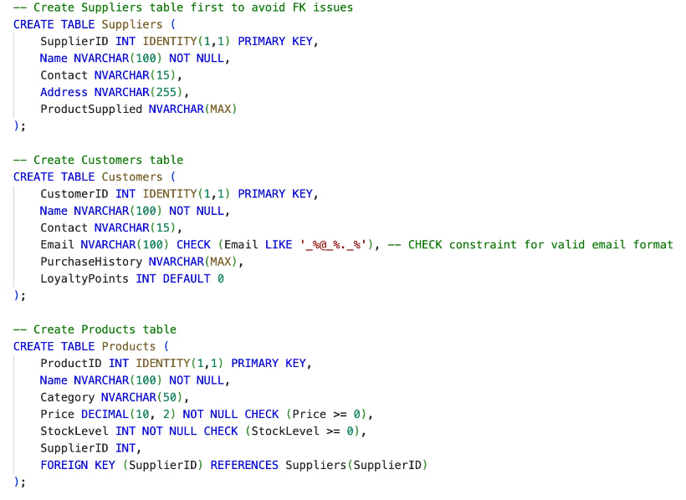
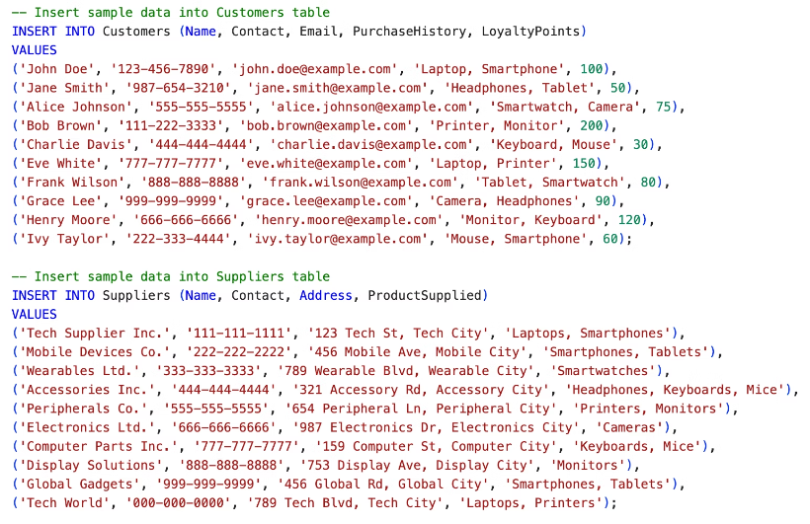
DDL & DML
Data Definition Language (DDL)
Data Manipulation Language (DML)

Slide 5
Constraints
Primary and Foreign Key Constraints
DEFAULT Constraints:
CHECK Constraints:
SaleDate defaults to current date and time (GETDATE())
Product prices and stock levels must be non-negative
New customers start with 0 loyalty points
Sale quantities must be greater than zero
Transaction dates automatically capture current timestamp
Email addresses must follow valid format
Employee salaries must be between 1000 and 10000
UNIQUE Constraints:
Email addresses must be unique across customers
Invoice numbers must be unique for each sale

Slide 6
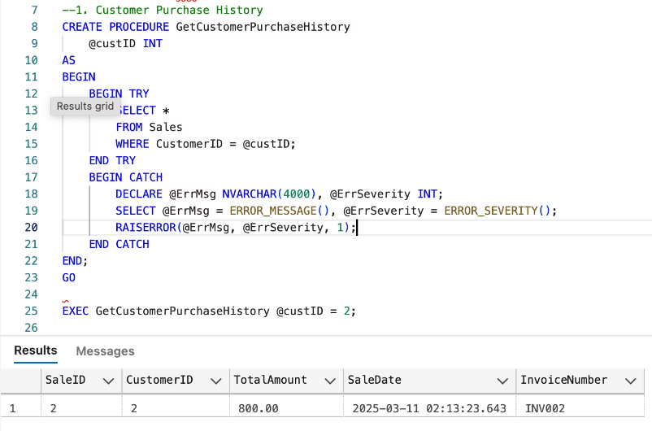
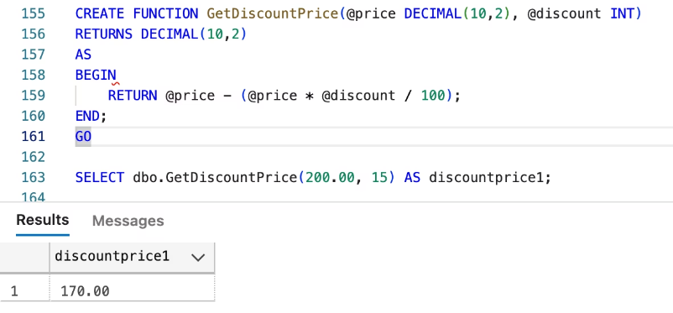
Stored Functions and User Defined Functions
Stored Functions
User Defined Functions

Slide 7
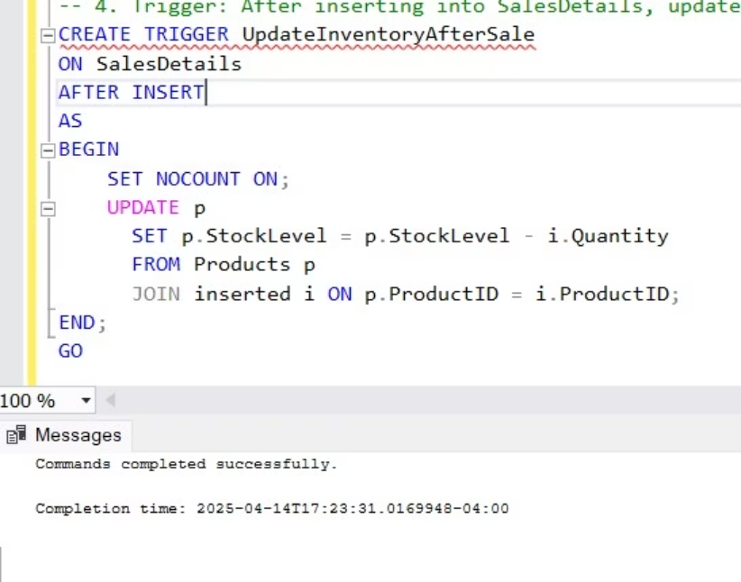
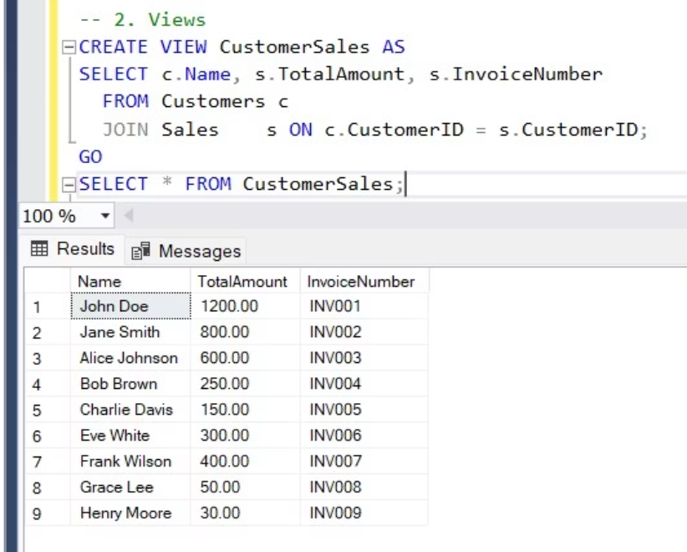
Triggers and Views
Triggers
Views

Slide 8
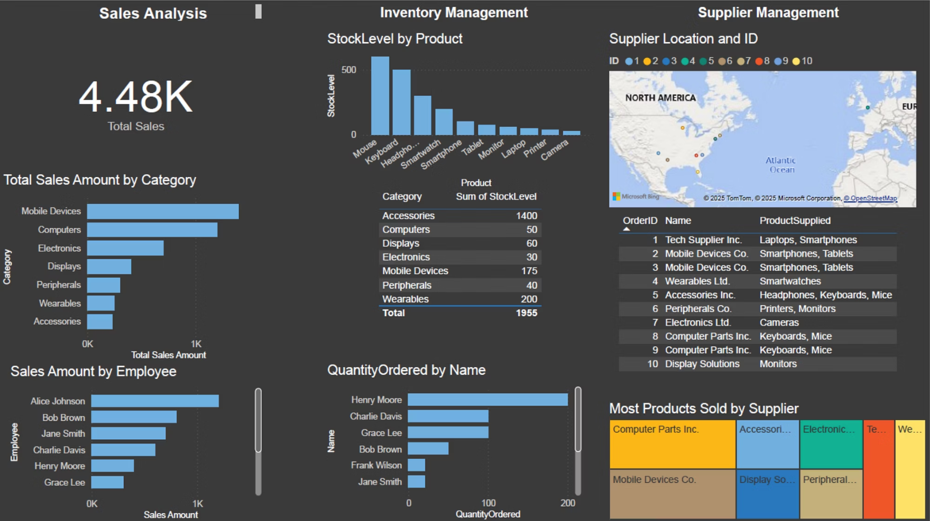
Dashboard

Slide 9
THANK YOU!

